Slide 1
Identification of insects and prediction of pesticides using deep learning
Team: Bryclay
PROJECT SUPERVISOR: MRS. MAIBAM MANGALLEIBI CHANU
Gunakar Challa- 17103032
Ketavath Prabhakar- 17103048

Slide 2
Contents
Abstract and aim & objective
Proposed algorithm explanation
Downloading images from google
Labeling the images with bounding boxes
TRAINING DARK NET YOLO V4 ON CUSTOM DATA
OPTIMIZING THE MODEL FOR UBIOPS SERVER
UBIops API request and response format
Flutter for connection with ubiops
Creation of database
Creation of APIs using php
CONNECTION TO 000WEBHOST AND API MANAGEMENT
Flow Diagram
Hardware and software requirements
Input and output
advantages

Slide 3
ABSTRACT:
YOLO algorithm , originally developed to recognise multiple different objects is now trained on custom data to recognise various insects.
After inferencing insect name , crop name is slected. And this combination is used to send the SQL query to lookup the relational database and get the corresponding record details of pesticides.
AIM AND OBJECTIVE :
To take an insect image and crop name as input and produce a list of suitable pesticides as output.

Slide 4
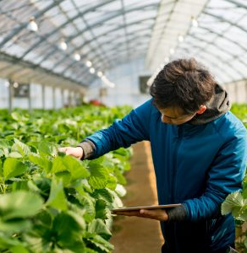
There are number of agricultural pests which damage health of the crop ultimately leading to low and poor quality yield.
This is mainly controlled by spraying the required pesticide in the farm.
But the main challenge is to choose which pesticide to use to kill specific pest and also know whether the crop is compatible with it or not.
Farmers in general has to show the image to the pesticide vendor and has to rely on his knowledge to get the best possible pesticide.
INTRODUCTION:

Slide 5
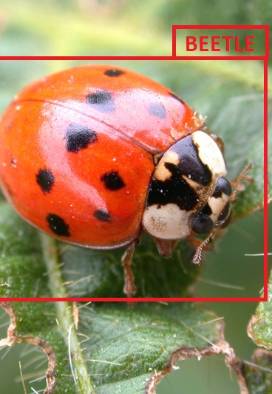
Our model uses image recognition technique to get the name of the pest and uses relational database to get the list of right pesticides.
Image Recognition
Image recognition, in the context of machine vision, is the ability of software to identify objects, places, people, writing and actions in images.
Computers can use machine vision technologies in combination with a camera and artificial intelligence software to achieve image recognition.

Slide 6
PROPOSED ALGORITHM EXPLANATION:
YOLO Algorithm:
YOLO Algorithm originally developed for object detection holds the capability to distinguish and detect several different objects in image.
It is extremely fast and accurate.
YOLO sees the entire image during training and test time so it so it implicitly encodes contextual information about classes as well as their appearance.
YOLO learns generalizable representations of objects so that when trained on natural images and tested on artwork, the algorithm outperforms other top detection methods.
YOLO Algorithm Explanation :
Takes an input image of shape (608, 608, 3)
Passes this image to a convolutional neural network (CNN), which returns a (19, 19, 5, 85) dimensional output

Slide 7
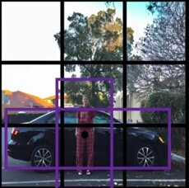
The last two dimensions of the above output are flattened to get an output volume of (19, 19, 425):
Here, each cell of a 19 X 19 grid returns 425 numbers
425 = 5 * 85, where 5 is the number of anchor boxes per grid
85 = 5 + 80, where 5 is (pc, bx, by, bh, bw) and 80 is the number of classes we want to detect
Finally, we do the IoU and Non-Max Suppression to avoid selecting overlapping boxes
Example
First we will take an image and divide it into grids, say 3x3

Slide 8
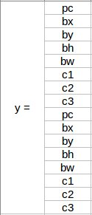
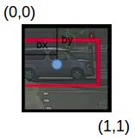
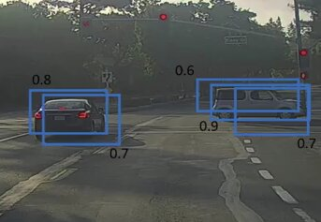
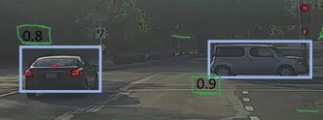
For each grid, we predict one or more classes as per number of anchor boxes per grid
Coordinates of bounding boxes are calculated relative to grid it contains
While predicting it may predict one object more than once, we eliminate it using non-max suppression.

Slide 9
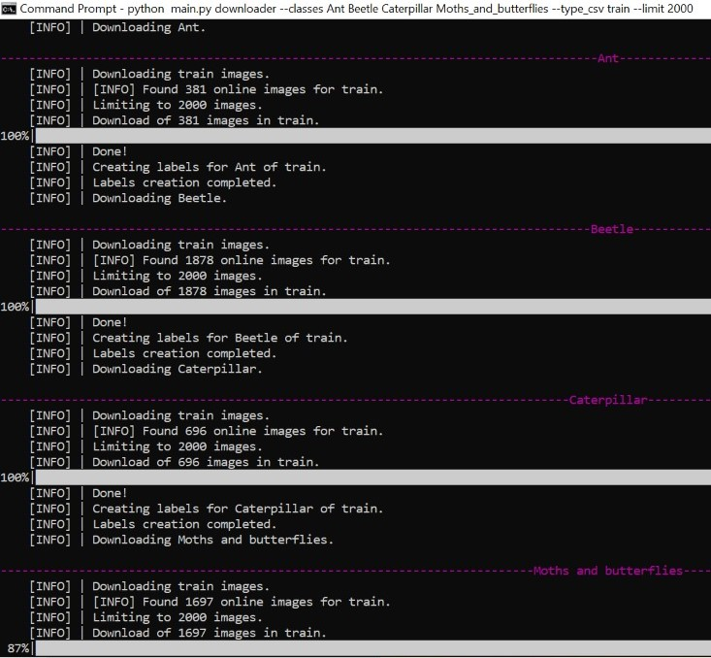
downloading images from google
→install simple image download using command “pip install simple_image_download” in anaconda prompt .
→open download_from_google.py and provide keywords and limit and download using “python download_from_google.py” command.

Slide 10
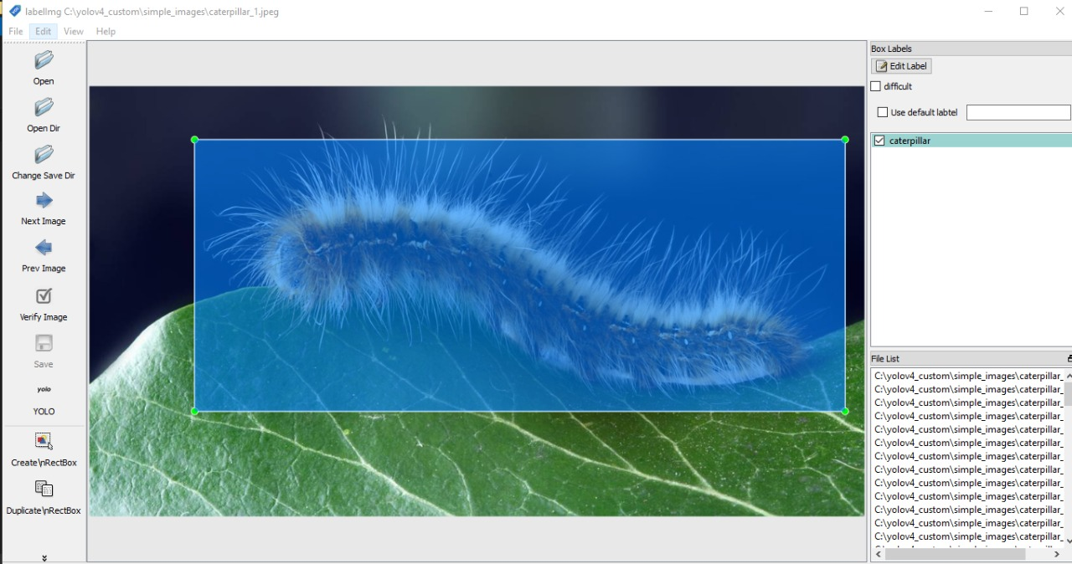
labeling images with bounding boxes
→for labelling download Binary v1.8.1 (for windows) and it contains data folder and labelling.exe and provide data.
→run labelling.exe and save format to yolo and open the directory that contains the images that we just downloaded.
→create a box and precise as much as possible then hit save.
→against each image will have one text file that will contain the annotations that just did and will also have classes.txt file that contains the actual name of the classes that using in annotations .
→Like this labell all the images .

Slide 11
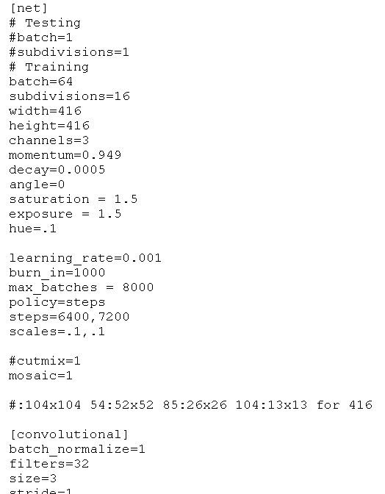
training dark net yolo v4 on custom data
→build darknet yolo v4 with gpu support.
→open dartnet folder there would be x64 folder ,open data folder and create a folder(name as obj) for labelled images.
→create a copy of two files obj.data and obj.names and rename with obj.Provide class names and data then hit save.
→open cfg folder and make a copy of yolo4-custom.cfg then open with any text editor.

Slide 12
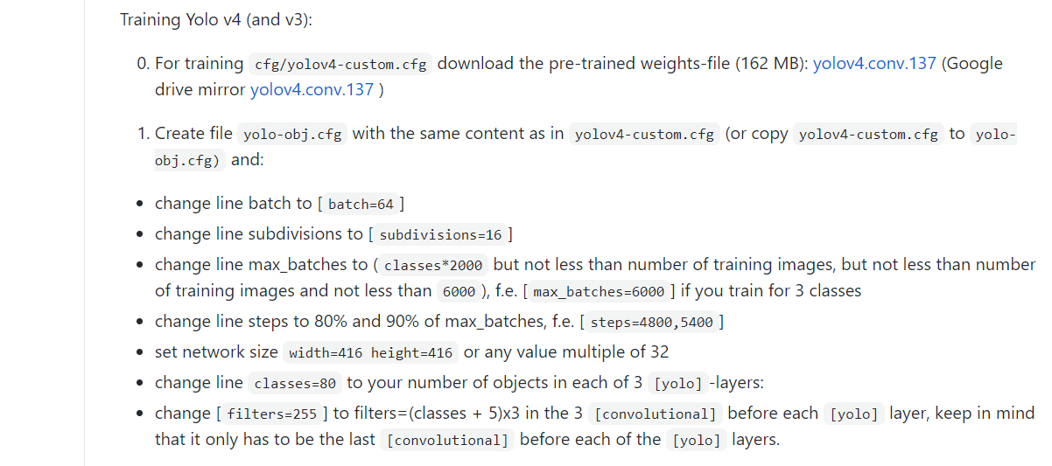
TRAINING YOLO V4:

Slide 13
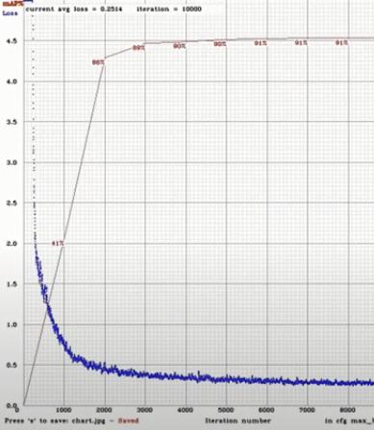

……………..
→download yolov4.conf.137 file that is basically a pre-trained weights file that utilize in training and place inside x64 folder.
→create list of images by using “python create_list_of_images.py “ command.
→start training by using the command line “darknet.exe detector train data/obj.data yolo-obj.cfg yolov4.conv.137”.
→ After completion of training the data graphs are created.

Slide 14
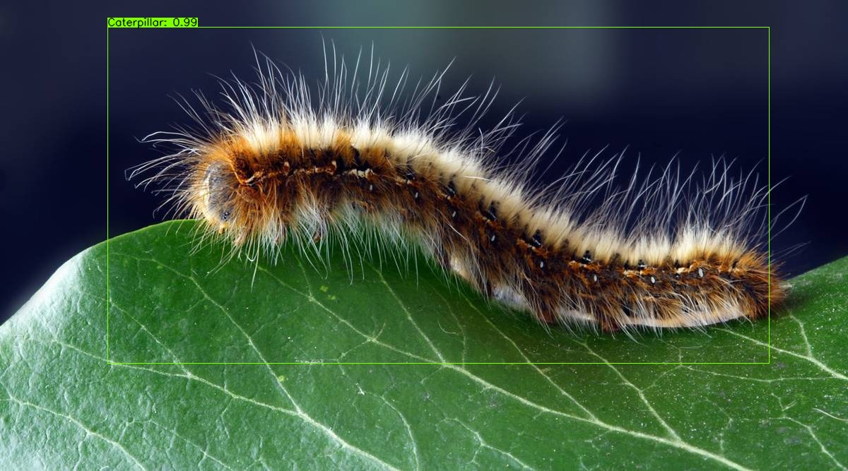
RESUMING TRAINING
→if we go to backup folder, there will be weight files after 1000 iterations.
→For resume the training use the command “darknet.exe detector data/obj.data cfg/yolov4-obj.cfg backup/yolov4-obj_last.weights -c 0”.
→to run inferencing on the custom trained model issue this command “darknet.exe demo data/obj.data cfg/yolov4-obj.cfg backup/yolov4-obj_last.weights wick.mp4 -thresh 0.6 “.
→to run object detection on images execute this command “darknet.exe detector test data/obj.data cfg/yolov4-obj.cfg backup/yolov4-obj_last.weights”. Then the image would be detected.

Slide 15
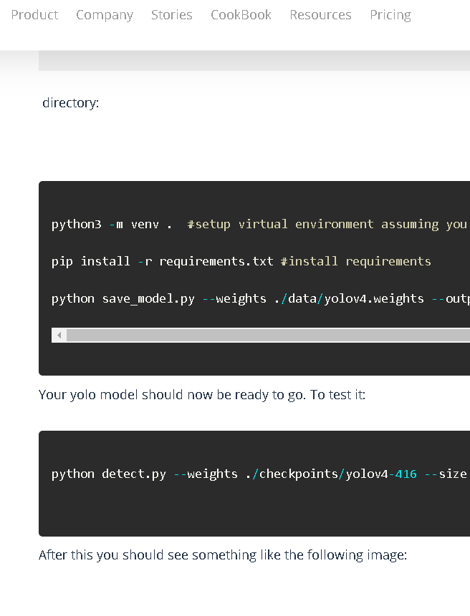
Optimizing the model for ubiops server
→Clone the repository and download the zip file tensorflo-yolov4-flite and extract it.
→copy the yolov4-obj_last.weights file of dartnet into the data folder of tensorflow-yolov4-flite and also copy obj.names file into the classes folder of tensorflow-yolov4-flite.Insode core folder open config.py and make necessary changes.
→for conversion use command “python save_model.py --weights ./data/yolov4.weights --output ./checkpoints/yolov4-416 --input_size 416 --model yolov4 “.To run object detection use command “python detect.py --weights ./checkpoints/yolov4-416 --size 416 --model yolov4 --image ./data/kite.jpg “.

Slide 16
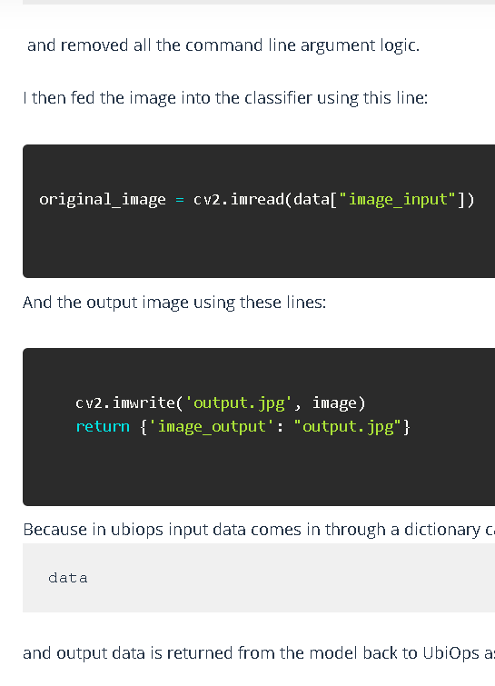
->Now that we have a working model we need to adapt it a bit so that UbiOps can use it. Now we have the "detect.py" with the functionality in it to classify images like we just did. UbiOps however expects a model.py with a specific structure.
-> the model.py needs to have a “model” class which contains 2 methods. The methods are init and request. UbiOps can also use a requirement.txt to automatically install dependencies.
-> fed the image into the classifier using this line:
original_image = cv2.imread(data["image_input"])
And the output image using these lines:
cv2.imwrite('output.jpg', image) return {'image_output': "output.jpg"}
-> Because UbiOps does not provide a desktop environment and the opencv library, change opencv-python to opencv-python-headless. Remove cv.show() call, which requires a desktop environment.
->In order for ubiops to accept our files it needs to be in a directory called model_package, so rename yolov4model to model_package. Now zip the whole model_package directory. Important is to have the model.py file and the model_package directory.

Slide 17
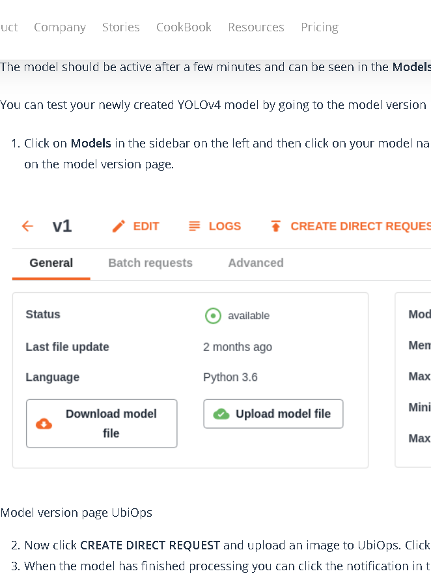
->Go to UbiOps and login.In the sidebar on the left go to Models -> Create.Set the Name.Set Input type to structured. Add an input field image_input with data-type file. Set Output type to structured.Add an output image_output with data-type file.
->Input and Output in UbiOps: Click Next Step and then Confirm.Set the Language to Python 3.7.Upload the zipped model package and click on the Create button.Model can be seen in the Models overview page.
->Click on Models in the sidebar on the left and then click on your model name(yolov4) and then on one of the versions (v1). Now click CREATE DIRECT REQUEST and upload an image to UbiOps. Click Create to create the request.
When the model has finished processing we can click the notification in the right bottom named Results and see the results of our request.

Slide 18
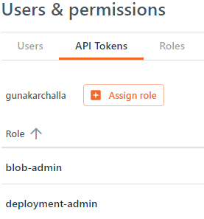
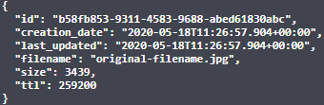
UBIops API request and response format(setting up api tokens assigning roles & uploading blob)

Slide 19

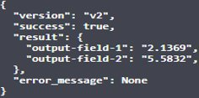
(deployment request & Downloading blob)

Slide 20
Flutter connection with ubiops(uploading blob)
We have used Image_Picker package provided by flutter to create a widget wherein one can choose the picture of insect from gallery of their phones and save it in a file variable.
We have used Flutter's multi part request function to send the image file in HTTP request to UbiOps deployment endpoint. We have added Authorisation header and assigned the value of Token generated by us. Also added blob-ttl header which decides how much time(in seconds) the blob should stay in server before automatic deletion and assigned a value of 900(15 minutes). This reduces unnecesary storage of uploaded files.
The response specifies various parameters like id, ttl, size, creation_date,etc Out of which the main parameters to be used is id of the blob uploaded.
Status code and Response of Uploading blob request:

Slide 21
(Deployment request)
We have used multi part request function to call deployment request. We have to add Authorisation token in header. Also we have to specify the blob id, in the body of request in json format, on which the deployment request has to run.
The request takes 30 to 40 seconds depending upon the image size and internet speed of mobile phone.
The response specifies various parameters like request_id, version, success, result,etc Out of which the main parameters to be used in next step is result parameter which specifies the output image blob id of the deployment request.
Status code and Response of Deployment request:

Slide 22
(Downloading blob)
We have used NetworkImage function to download and show the output blob. We have to add Authorisation token in header. We have used an asset image (downloading picture) as a place holder until the downloading finishes and is displayed. Also we have to specify the blob id, in the url of the request.
The will be getting file in resonse body.

Slide 23
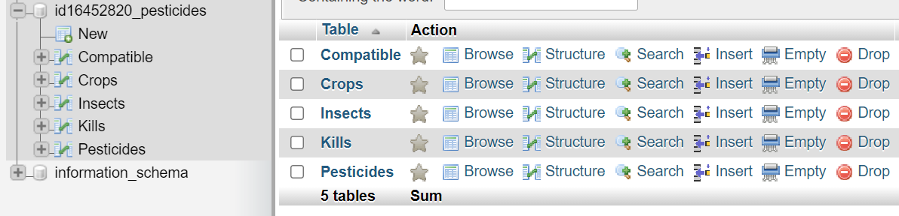
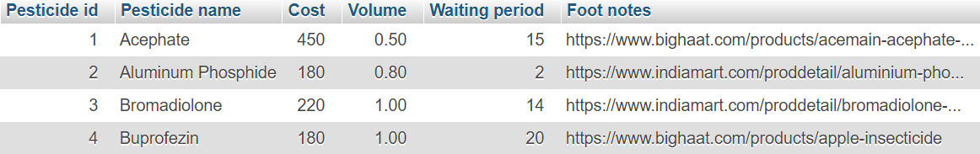
Creation of database (Pesticides table)

Slide 24
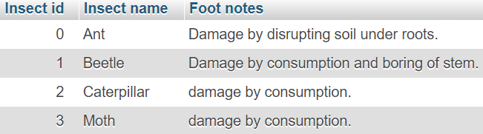
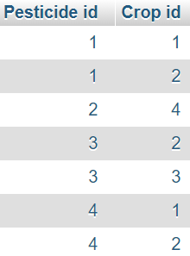
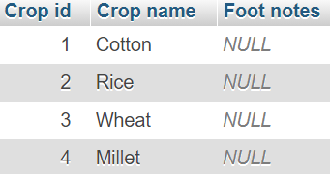
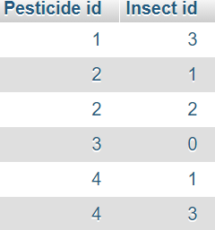
(Insects, Crops, Compatible & Kills tables)

Slide 25
CREATION OF APIS USING PHP (get ALL CROPS)
We have created a PHP script which acts as API in file manager of 000webhost.com
There we have created variables which store the credentials of database. Then we create a connection variable to database using mysqli_connect function.
We then execute "SELECT * FROM Crops" sql query and store all results in json format.
We then send this json tree to client calling the API.
API query URL:
http://bryclay.000webhostapp.com/getallcrops.php
Status code and response of get all crops API:

Slide 26
(get all insects)
Same as get all crops but change in SQL query.
SQL query: "SELECT * FROM Insects"
API query URL:
http://bryclay.000webhostapp.com/getallinsects.php
Status code and response of get all insects API:

Slide 27
(get required pesticides)
Same as get all crops but change in SQL query and body parameters has to be added so as to select combination of insect and crop.
SQL query: "SELECT * FROM Pesticides WHERE `Pesticide id` IN (SELECT C.`Pesticide id` FROM Compatible AS C INNER JOIN Kills AS K on C.`Pesticide id`=K.`Pesticide id` WHERE C.`Crop id`=(SELECT `Crop id` FROM Crops WHERE `Crop name`='$crop') AND K.`Insect id`=(SELECT `Insect id` FROM Insects WHERE `Insect name`='$insect'))"

Slide 28
Connection to 000webhost and api management
We have used http package provided by flutter to send http get request to fetch insects & crops and http post request to fetch pesticides.
We have added body parameters of type form-data to get required pesicides query.
We have saved the response json tree in an Map, which is equivalent to dictionary in python, which is a datastructure used to store data in key-value pairs.
Then we iterated through map to save each name of insect/crop in a list of strings.
We have used builder functions to create a list item widget for each of pesticide received in json tree.

Slide 29
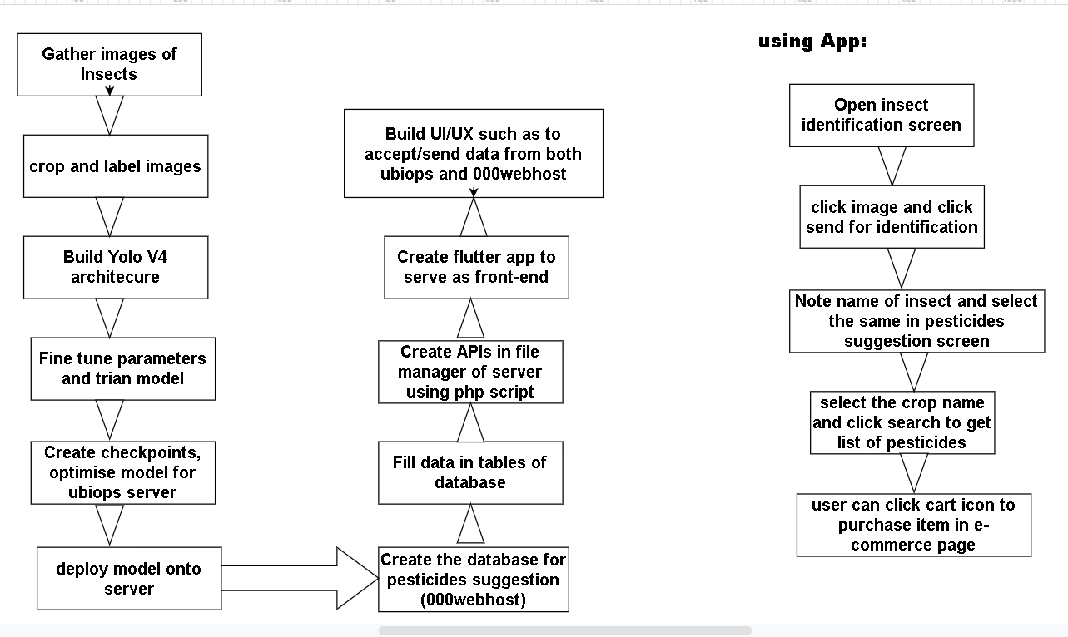
FLOW DIAGRAM:

Slide 30
HARDWARE AND SOFTWARE REQUIREMENTS:
Laptop/Desktop with at least following specifications:
Hardware: 1.Free storage 5GB
2. 8 GB RAM
3. Intel core i3 8th generation.
Software: 1. Windows OS with windows 7 SP1 (or) macOS with version 10.10
2. Git 2.0
Smartphone/Mobile with at least following specifications:
Hardware: 1.Free storage 200MB
2. Processor with at least one core more than 1GHz
3. 1GB RAM and Camera 5MP
Software: Android OS 4.1 (or) iOS 8
Internet connection with speed at least 0.5 Mbps.

Slide 31
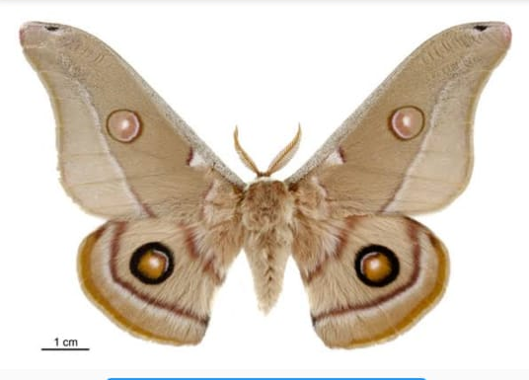
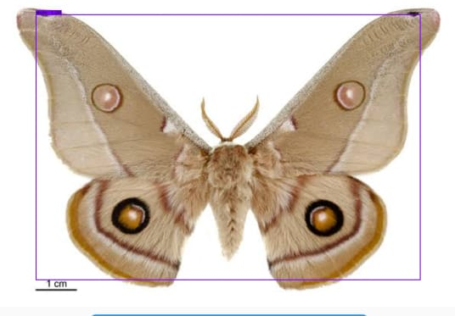
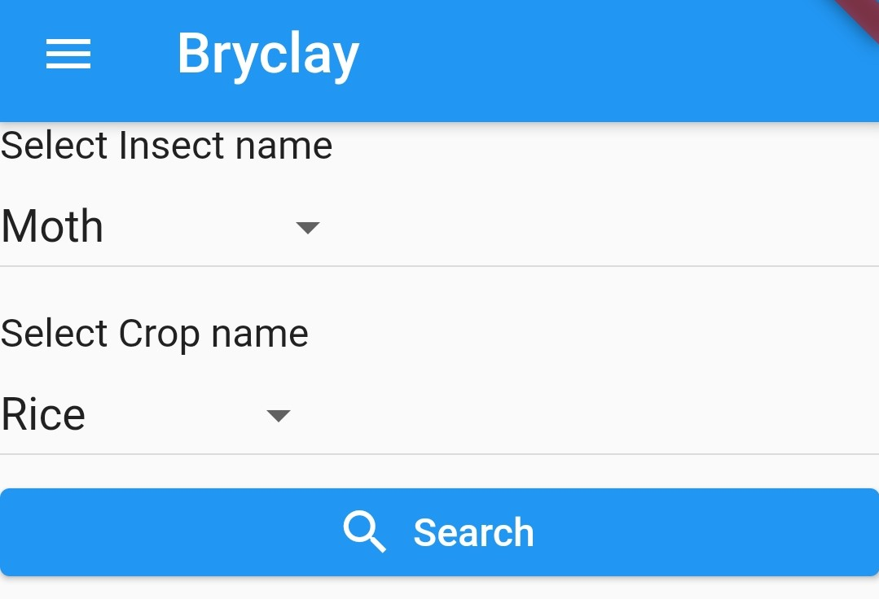
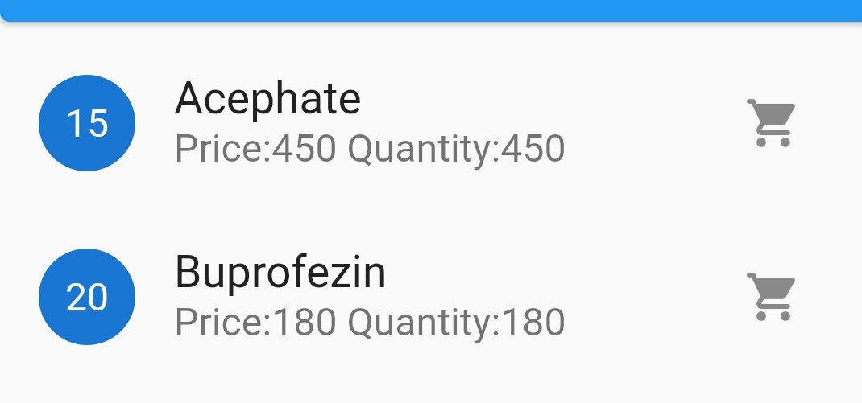
INPUT AND OUTPUT:
Input: Output:
1.Insert Picture : 1. Detected image:
2.Insect & Crop Selection: 2. List of pesticides

Slide 32
ADVANTAGES:
Whole process uses minimal computation power on smartphone, hence is very efficient and doesn't require high end smartphones.
Farmer is able to get details of campatible pesticides using his smartphone within minutes, hence process is very convenient.
Database is filled with the help of experts, therefore the information retrieved is very correct and reliable.
The whole recognition model is deployed in Ubiops server hence it is very convinient to deploy improvised model.
The suggestion system is deployed in 000webhost server hence it is easy to increase the classes of crops and pesticides.
This is a viable bussiness model wherein admin can use affiliate links to generate revenue instead of annoying ads.

Slide 33
Thank you

